Slide 1
Auctions

Slide 2
Agenda
Auctions: Theory and Applications
Hemant Bhargava
Some Python
See Python file on Canvas
Quiz debrief

Slide 3
Important Concepts from Game Theory
Nash equilibrium vs. Stackelberg equilibrium
Best response function (or reaction function)
Dominant Strategy
Incentive compatible

Slide 4
Applications of Non-Cooperative GT
Standards adoption
Price wars
Advertising Game
Standards war
Patent races
Capacity Expansion
Sales Force compensation
Paid Search Advertising
Coordination
Prisoner’s dilemma
Prisoner’s dilemma
War of attrition
War of attrition
Commitment
Principal-Agent Framework
Auctions

Slide 5
Small Game
Winner: Shruti Saxena
Special Mention for Jiaqin Ma

Slide 6
Nash Equilibrium

Slide 7

Ads on YouTube

Slide 8
Definition of the Game
What is the market?
Who are the players?
What are their strategies?

Slide 9
Nash Equilibrium
The market maker (or platform) decides the pricing scheme
Second Price Auction
Bidders’ optimal strategies is to bid their true values
Bidding truthfully is the Nash equilibrium
It is “Incentive Compatible”

Slide 10

Hemant Bhargava

Slide 11
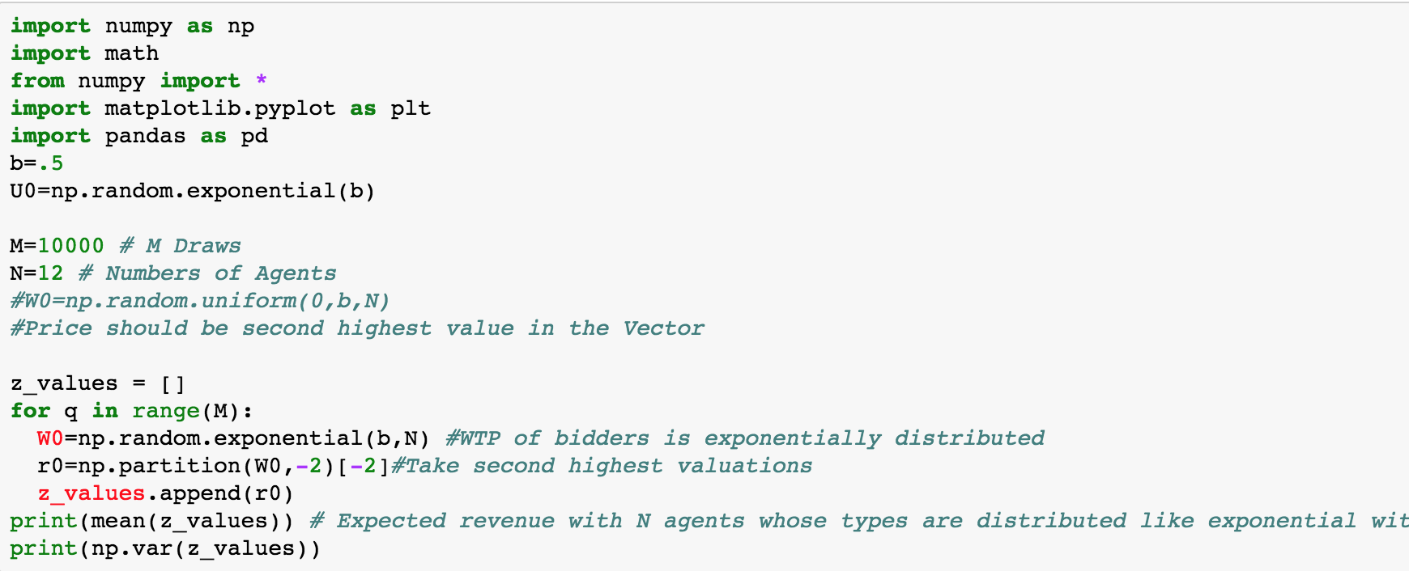
Profit under Second Price Auction

